Slide 1

Investigating the Effect of State Anxiety on Real-Time Sensory Processing in Relation to Autistic Traits using Virtual Reality Environments
Mark Griffin
Supervisor – Dr David Simmons

Slide 2



Terminology
Autism Spectrum Disorder (ASD) is the clinical term used in the DSM-5-TR and ICD-11.
ASD will be referred to using “autism” and “autistic”.
These are the endorsed terms across English speaking autistic communities (Keating et al., 2022).
Autism Spectrum Disorder (ASD) is the clinical term used in the DSM-5-TR and ICD-11.
ASD will be referred to using “autism” and “autistic”.
These are the endorsed terms across English speaking autistic communities (Keating et al., 2022).

Slide 3
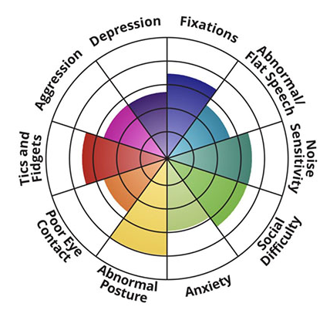
Autism
Atypical sensory processing is prominent in autistic children and adults (Horder et al., 2014; Millington et al., 2021).
Anxiety is central to the autistic experience.
Self-reported as a main challenge in daily life (Trembath et al., 2012).
Significantly moderates quality of life in autism (Smith et al., 2019).

Slide 4
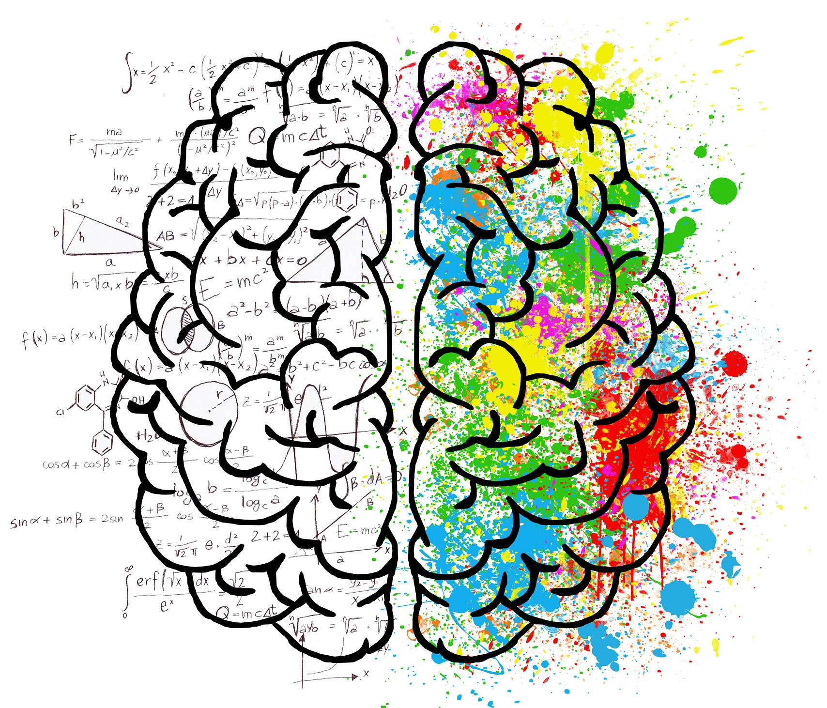
Single-Path Model
Wigham et al. (2015) unified anxiety, atypical sensory processing and repetitive behaviours.
Sensory sensitivities predict anxiety later in life.
Repetitive behaviours are an anxiety reducer.
Replicated in adults (Hwang et al., 2020).
However,
Follows underpowered assumption from Green et al. (2012).
Qualitative reports indicate bidirectionality (MacLennan et al., 2021; Robertson & Simmons, 2015).
Repetitive behaviours predict anxiety (Baribeau et al., 2020).

Slide 5
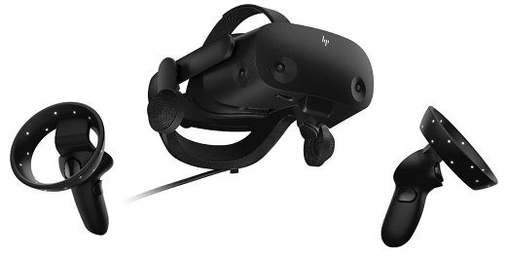
Virtual Reality Technology
Virtual reality (VR) uses head-mounted displays to immerse people in virtual 3D environments.
Increasing popularity in psychology research.
VR methods used successfully:
Demonstrate sensory processing differences (Arthur et al., 2021).
Intervention tool for autistic individuals (Glaser & Schmidt, 2022).
Manipulate levels of state anxiety (Graja et al., 2020).

Slide 6
Aims
Validate VR as a tool to induce varying levels of state anxiety to study sensory processing differences related to autism.
Investigate immediate effect of state anxiety on real-time sensory processing in relation to autistic traits.

Slide 7

Participants and Materials
Pre-Test Questionnaires:
Demographic Information Questionnaire.
Autism-Spectrum Quotient (Baron-Cohen et al., 2001).
State-Trait Anxiety Inventory 5-item (Zsido et al., 2020).
Glasgow Sensory Questionnaire (Robertson & Simmons, 2013).
N = 35

Slide 8
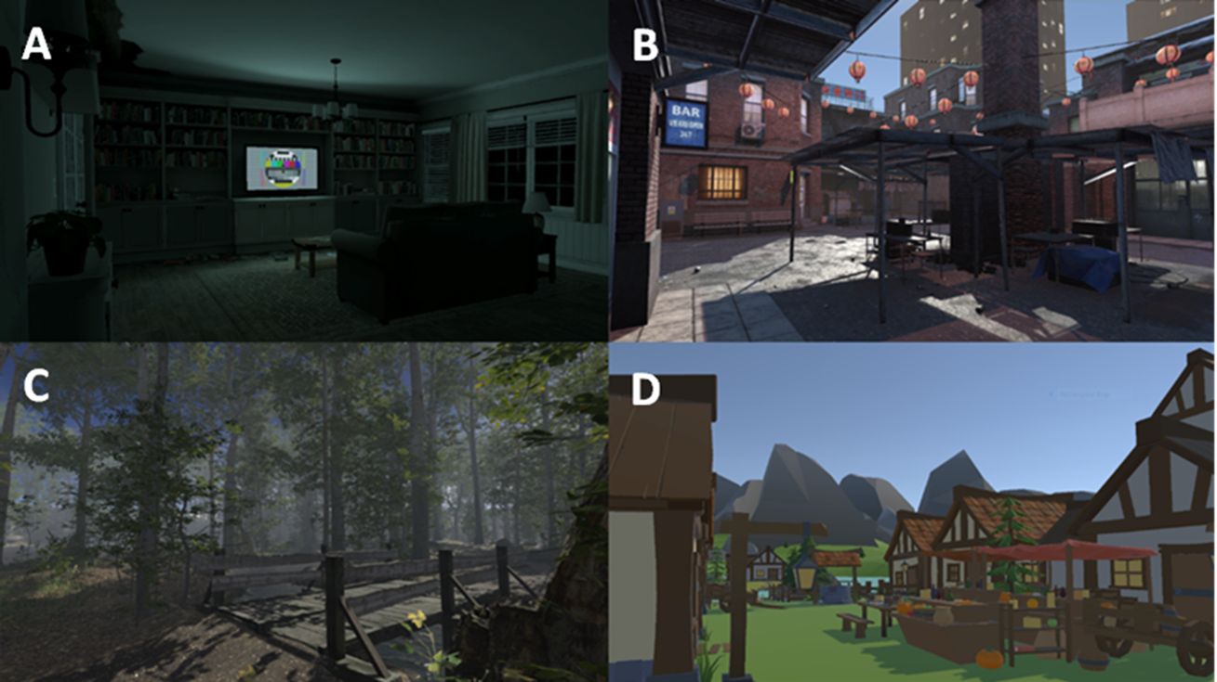
VR Programme
Virtual Environments:
A = Night-Time House
B = Generic City
C = Quiet Forest
D = Low Polygon Village

Slide 9
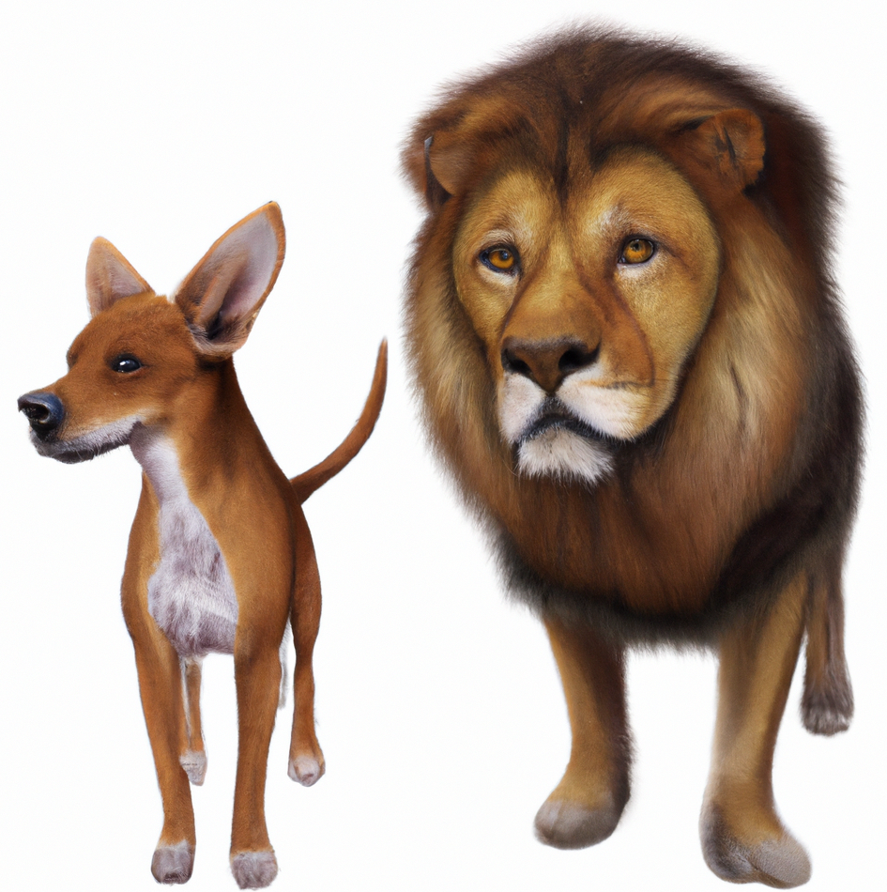

Sensory Processing Task
Auditory Processing Task (Remington & Fairnie, 2017).
48 trials, on each either the sound of a dog or lion is presented.
Occasionally the sound of a car engine is also presented.
“Did you hear a dog or lion?”
“Did you hear the car?”
State Anxiety Measures:
Heart Rate and Pupil Dilation
STAIS-5 (Zsido et al., 2020)

Slide 10
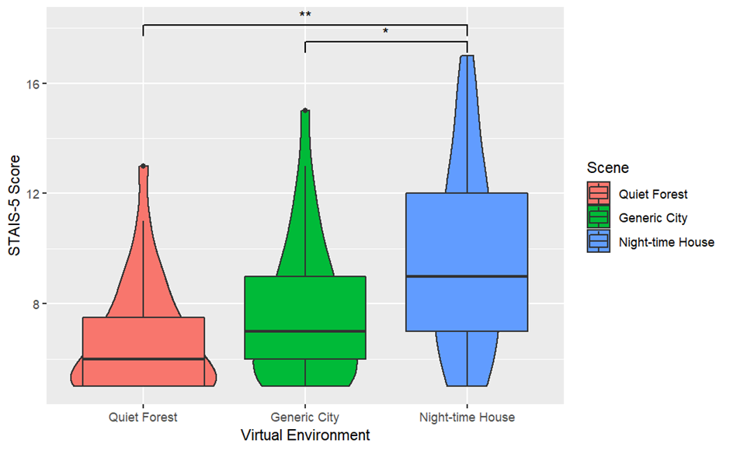
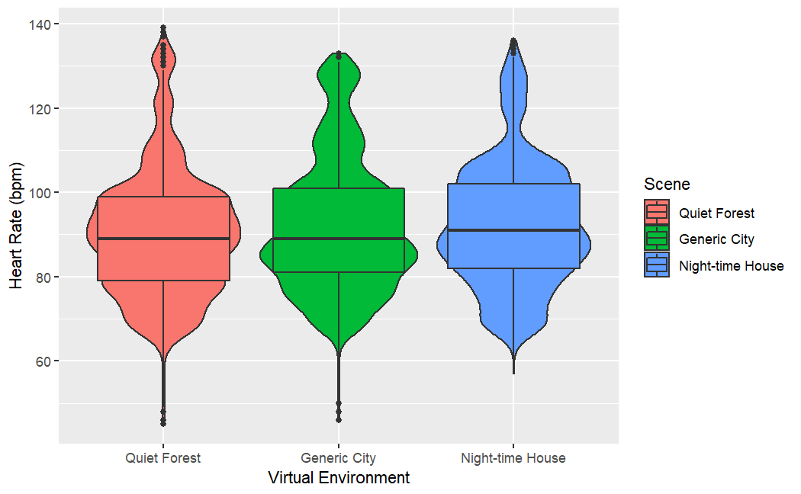
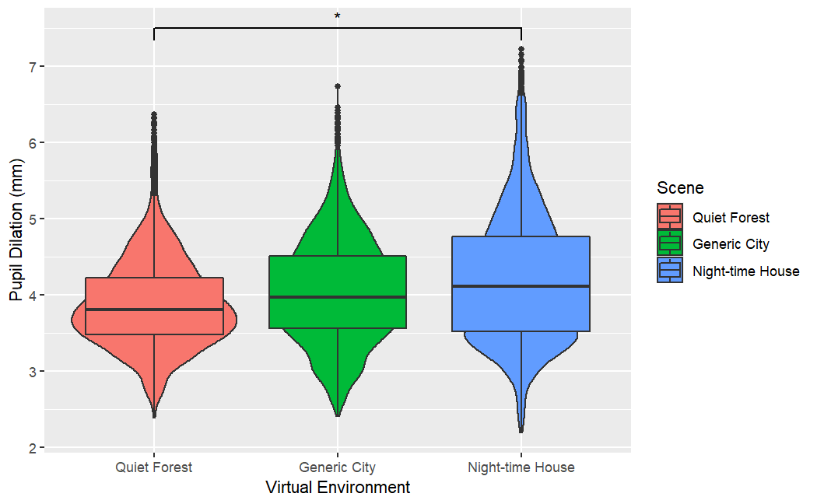
VR and State Anxiety
STAIS-5 Score
Heart Rate
Pupil Dilation
(H₍₂₎ = 16.48, p < 0.001)
F-H (Z = 4.03, p_{adj} < 0.001)
C-H (Z = -2.43, p_{adj} = 0.047)
(H₍₂₎ = 0.66, p = 0.72)
No significant differences
(H₍₂₎ = 7.41, p = 0.025)
F-H (Z = 2.27, p_{adj} = 0.020)

Slide 11
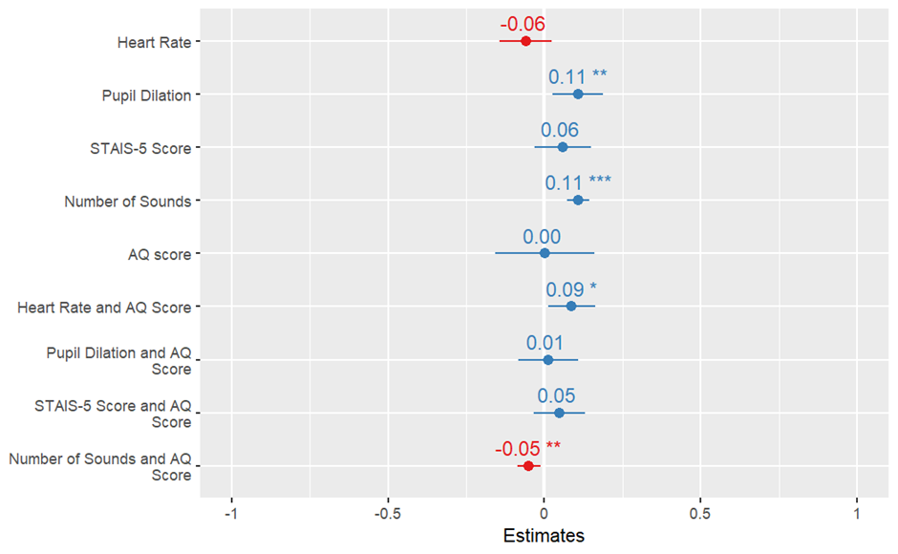
Sensory Processing Speed
Significant small-sized effects
Pupil Dilation
(F = 0.11, p = 0.010)
Number of Sounds
(F = 0.11, p < 0.001)
Heart Rate x AQ Score
(F = 0.09, p = 0.025)
Number of Sounds x AQ Score
(F = -0.05, p = 0.008)

Slide 12
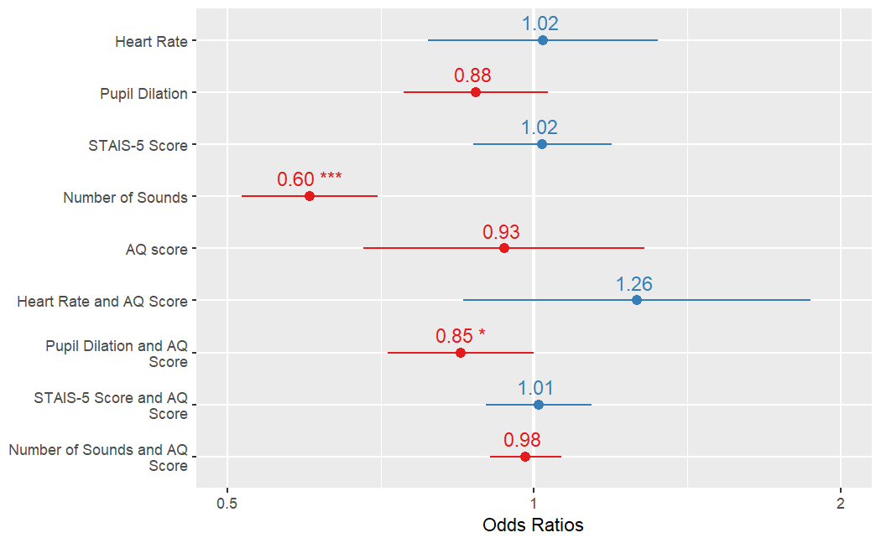
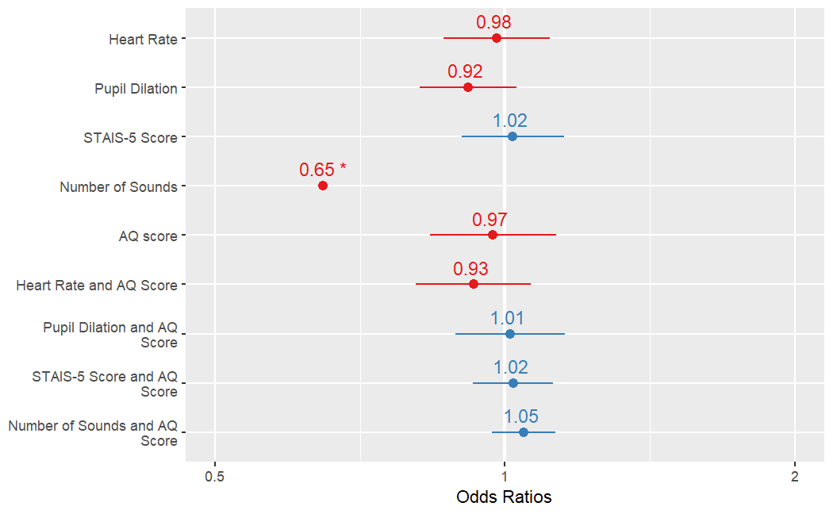
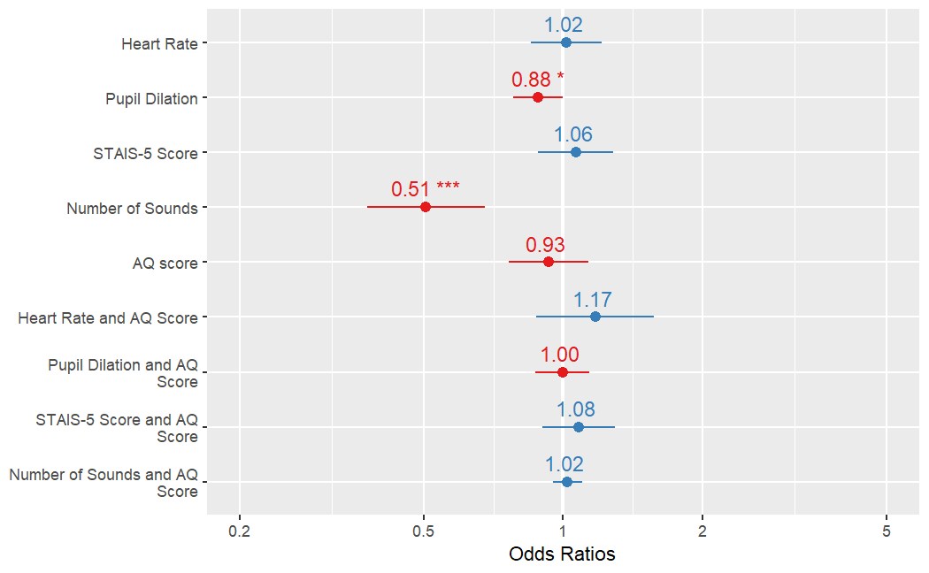
Sensory Processing Accuracy
Target Stimulus
Critical Stimulus
Both Stimuli
Small-sized significant effect
Pupil Dilation x AQ Score
(F = -0.17, p = 0.049)
Medium-sized significant effect
Number of Sounds
(F = -0.51, p < 0.001)
Medium-sized significant effect
Number of Sounds
(F = -0.43, p = 0.010)
Small-sized significant effect
Pupil Dilation
(F = -0.13, p = 0.043)
Medium-sized significant effect
Number of Sounds
F = (-0.68, p < 0.001)

Slide 13
Summary of Findings
Virtual environments induced significant differences in state anxiety.
Supports previous findings (Chittaro, 2014; Graja et al., 2020).
No significant effect on heart rate.
Attributed to measurement errors.
Greater effects on sensory processing speed than accuracy.
Small-sized effects of state anxiety and autistic traits on sensory processing.
Aligns with qualitative reports (MacLennan et al., 2021; Robertson & Simmons, 2015).
Contradicts single-path model (Wigham et al., 2015).
Replicated findings by Remington and Fairnie (2017).

Slide 14

Limitations
Validity of auditory processing task.
Sensory sensitivities vary across modalities (Thye et al., 2018).
Ecological validity of auditory processing task.
Incongruent stimuli with environments.
Generalisability to autistic population.
SNS hypo-responsiveness (Hollocks et al., 2014), despite equal subjective anxiety (Hollocks et al., 2016).

Slide 15
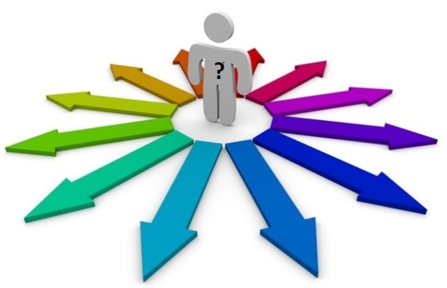
Future Directions
Replication in autistic sample.
Replication across sensory modalities.
Further investigation of role of auditory load.

Slide 16
Thank you for listening! Any questions are welcome

Slide 17
References
American Psychiatric Association. (2022). Diagnostic and statistical manual of mental disorders (5th ed., text rev.). https://doi.org/10.1176/appi.books.9780890425787
Arthur, T., Harris, D., Buckingham, G., Brosnan, M., Wilson, M., Williams, G., & Vine, S. (2021). An examination of active inference in autistic adults using immersive virtual reality. Scientific Reports, 11(1), 1-14. https://doi.org/10.1038/s41598-021-99864-y
Baribeau, D. A., Vigod, S., Pullenayegum, E., Kerns, C. M., Mirenda, P., Smith, I. M., ... & Szatmari, P. (2020). Repetitive behavior severity as an early indicator of risk for elevated anxiety symptoms in autism spectrum disorder. Journal of the American Academy of Child & Adolescent Psychiatry, 59(7), 890-899. https://doi.org/10.1016/j.jaac.2019.08.478
Baron-Cohen, S., Wheelwright, S., Skinner, R., Martin, J., & Clubley, E. (2001). The autism-spectrum quotient (AQ): Evidence from asperger syndrome/high-functioning autism, males and females, scientists and mathematicians. Journal of Autism and Developmental Disorders, 31, 5-17. https://doi.org/10.1023/A:1005653411471
Bitsika, V., Sharpley, C. F., Sweeney, J. A., & McFarlane, J. R. (2014). HPA and SAM axis responses as correlates of self-vs parental ratings of anxiety in boys with an Autistic Disorder. Physiology & Behavior, 127, 1-7. https://doi.org/10.1016/j.physbeh.2013.12.011
Chittaro, L. (2014). Anxiety induction in virtual environments: an experimental comparison of three general techniques. Interacting with Computers, 26(6), 528-539. https://doi.org/10.1093/iwc/iwt049
Foreman, N. (2010). Virtual reality in psychology. Themes in Science and Technology Education, 2(1-2), 225-252.
Glaser, N., & Schmidt, M. (2022). Systematic literature review of virtual reality intervention design patterns for individuals with autism spectrum disorders. International Journal of Human–Computer Interaction, 38(8), 753-788. https://doi.org/10.1080/10447318.2021.1970433
Graja, S., Lopes, P., & Chanel, G. (2020). Impact of visual and sound orchestration on physiological arousal and tension in a horror game. IEEE Transactions on Games, 13(3), 287-299. https://doi.org/10.1109/TG.2020.3006053
Green, S. A., Ben-Sasson, A., Soto, T. W., & Carter, A. S. (2012). Anxiety and sensory over-responsivity in toddlers with autism spectrum disorders: Bidirectional effects across time. Journal of Autism and Developmental Disorders, 42(6), 1112-1119. https://doi.org/10.1007/s10803-011-1361-3
Hollocks, M. J., Howlin, P., Papadopoulos, A. S., Khondoker, M., & Simonoff, E. (2014). Differences in HPA-axis and heart rate responsiveness to psychosocial stress in children with autism spectrum disorders with and without co-morbid anxiety. Psychoneuroendocrinology, 46, 32-45. https://doi.org/10.1016/j.psyneuen.2014.04.004
Hollocks, M. J., Pickles, A., Howlin, P., & Simonoff, E. (2016). Dual cognitive and biological correlates of anxiety in autism spectrum disorders. Journal of Autism and Developmental Disorders, 46(10), 3295-3307. https://doi.org/10.1007/s10803-016-2878-2
Horder, J., Wilson, C. E., Mendez, M. A., & Murphy, D. G. (2014). Autistic traits and abnormal sensory experiences in adults. Journal of Autism and Developmental Disorders, 44, 1461-1469. https://doi.org/10.1007/s10803-013-2012-7
Hwang, Y. I., Arnold, S., Srasuebkul, P., & Trollor, J. (2020). Understanding anxiety in adults on the autism spectrum: An investigation of its relationship with intolerance of uncertainty, sensory sensitivities and repetitive behaviours. Autism, 24(2), 411-422. https://doi.org/10.1177/1362361319868907
Keating, C. T., Hickman, L., Leung, J., Monk, R., Montgomery, A., Heath, H., & Sowden, S. (2022). Autism‐related language preferences of English‐speaking individuals across the globe: A mixed methods investigation. Autism Research. https://doi.org/10.1002/aur.2864
MacLennan, K., O’Brien, S., & Tavassoli, T. (2021). In our own words: The complex sensory experiences of autistic adults. Journal of Autism and Developmental Disorders, 1-15. https://doi.org/10.1007/s10803-021-05186-3

Slide 18
References
Malihi, M., Nguyen, J., Cardy, R. E., Eldon, S., Petta, C., & Kushki, A. (2020). Evaluating the safety and usability of head-mounted virtual reality compared to monitor-displayed video for children with autism spectrum disorder. Autism, 24(7), 1924-1929. https://doi.org/10.1177/1362361320934214
Millington, E., Brown, L., McMahon, H., Robertson, A. E., & Simmons, D. (2021). Children’s Glasgow Sensory Questionnaire (C-GSQ): Validation of a Simplified and Visually Aided Questionnaire.
Neil, L., Olsson, N. C., & Pellicano, E. (2016). The relationship between intolerance of uncertainty, sensory sensitivities, and anxiety in autistic and typically developing children. Journal of Autism and Developmental Disorders, 46(6), 1962-1973. https://doi.org/10.1007/s10803-016-2721-9
Remington, A., & Fairnie, J. (2017). A sound advantage: Increased auditory capacity in autism. Cognition, 166, 459-465. https://doi.org/10.1016/j.cognition.2017.04.002
Robertson, A. E., & Simmons, D. R. (2013). The relationship between sensory sensitivity and autistic traits in the general population. Journal of Autism and Developmental disorders, 43(4), 775-784. https://doi.org/10.1007/s10803-012-1608-7
Robertson, A. E., & Simmons, D. R. (2015). The sensory experiences of adults with autism spectrum disorder: A qualitative analysis. Perception, 44(5), 569-586. https://doi.org/10.1068/p7833
Simmons, D. R. (2019). Some clarifications on neural noise and sensory sensitivities in Autism. Cognitive Neuroscience, 10(3), 169-171. https://doi.org/10.1080/17588928.2019.1598349
Smith, I. C., Ollendick, T. H., & White, S. W. (2019). Anxiety moderates the influence of ASD severity on quality of life in adults with ASD. Research in Autism Spectrum Disorders, 62, 39-47. https://doi.org/10.1016/j.rasd.2019.03.001
Thye, M. D., Bednarz, H. M., Herringshaw, A. J., Sartin, E. B., & Kana, R. K. (2018). The impact of atypical sensory processing on social impairments in autism spectrum disorder. Developmental Cognitive Neuroscience, 29, 151-167. https://doi.org/10.1016/j.dcn.2017.04.010
Trembath, D., Germano, C., Johanson, G., & Dissanayake, C. (2012). The experience of anxiety in young adults with autism spectrum disorders. Focus on Autism and Other Developmental Disabilities, 27(4), 213-224. https://doi.org/10.1177/1088357612454916
Varbanov, V., Overton, P. G., & Stafford, T. (2023). ADHD and ASD traits are indirectly associated with sensory changes through anxiety. Current Psychology, 1-13. https://doi.org/10.1007/s12144-022-04217-1
Wigham, S., Rodgers, J., South, M., McConachie, H., & Freeston, M. (2015). The interplay between sensory processing abnormalities, intolerance of uncertainty, anxiety and restricted and repetitive behaviours in autism spectrum disorder. Journal of Autism and Developmental Disorders, 45(4), 943-952. https://doi.org/10.1007/s10803-014-2248-x
Wilson, C. J., & Soranzo, A. (2015). The use of virtual reality in psychology: A case study in visual perception. Computational and Mathematical Methods in Medicine, 2015. https://doi.org/10.1155/2015/151702
World Health Organization. (2019). International statistical classification of diseases and related health problems (11th ed.). https://icd.who.int/
Zsido, A. N., Teleki, S. A., Csokasi, K., Rozsa, S., & Bandi, S. A. (2020). Development of the short version of the spielberger state—trait anxiety inventory. Psychiatry Research, 291, 113223. https://doi.org/10.1016/j.psychres.2020.113223

